Slide 1
ECE314 Lab 14 Overview
Principal Component Analysis (PCA)

Slide 2
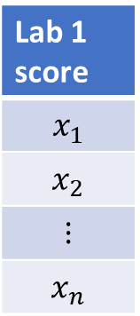
Lab 1 score
$$x_{1}$$
$$x_{2}$$
$$⋮$$
$$x_{n}$$
Lab 1

Slide 3
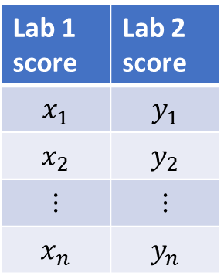
Lab 1 score | Lab 2 score
$$x_{1}$$ | $$y_{1}$$
$$x_{2}$$ | $$y_{2}$$
$$⋮$$ | $$⋮$$
$$x_{n}$$ | $$y_{n}$$
Lab 2
Lab 1

Slide 4


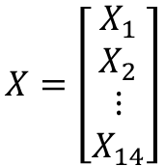
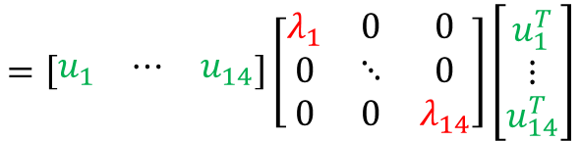

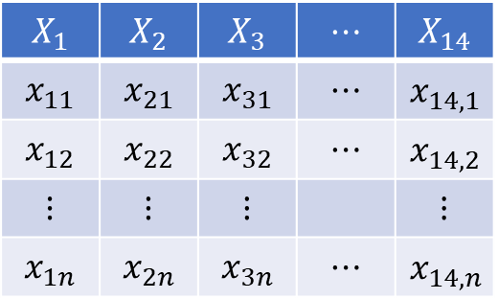


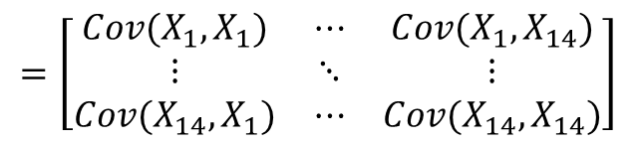



Principal Component Analysis
$$X_{1}$$ | $$X_{2}$$ | $$X_{3}$$ | $$⋯$$ | $$X_{14}$$
$$x_{11}$$ | $$x_{21}$$ | $$x_{31}$$ | $$⋯$$ | $$x_{14,1}$$
$$x_{12}$$ | $$x_{22}$$ | $$x_{32}$$ | $$⋯$$ | $$x_{14,2}$$
$$⋮$$ | $$⋮$$ | $$⋮$$ |  | $$⋮$$
$$x_{1n}$$ | $$x_{2n}$$ | $$x_{3n}$$ | $$⋯$$ | $$x_{14, n}$$
Goal: reduce the dimension of the data while preserving the most important features of the data for clustering/visualizing
$$\sqrt{λ_{2}}$$
$$x_{2}$$
$$u_{1}$$
2nd principal
direction
1st principal
direction
14x1
1x14
$$Cov\left(X\right)=E\left[\left(X−E\left[X\right]\right){\left(X−E\left[X\right]\right)}^{T}\right]$$
$$u_{2}$$
$$X=\left[\begin{matrix}X_{1} \\ X_{2} \\ ⋮ \\ X_{14}\end{matrix}\right]$$
$$=\left[\begin{matrix}Cov(X_{1}, X_{1}) & ⋯ & Cov(X_{1}, X_{14}) \\ ⋮ & ⋱ & ⋮ \\ Cov(X_{14}, X_{1}) & ⋯ & Cov(X_{14}, X_{14})\end{matrix}\right]$$
Random vector
$$\sqrt{λ_{1}}$$
$$=UΛU^{T}$$
$$x_{1}$$
Colum vector
$$=\left[\begin{matrix}u_{1} & ⋯ & u_{14}\end{matrix}\right]\left[\begin{matrix}λ_{1} & 0 & 0 \\ 0 & ⋱ & 0 \\ 0 & 0 & λ_{14}\end{matrix}\right]\left[\begin{matrix}u_{1}^{T} \\ ⋮ \\ u_{14}^{T}\end{matrix}\right]$$
$$=λ_{1}u_{1}u_{1}^{T}+⋯+λ_{14}u_{14}u_{14}^{T}$$

Slide 5



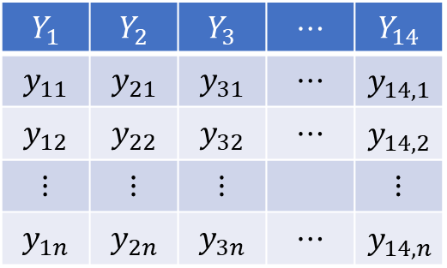
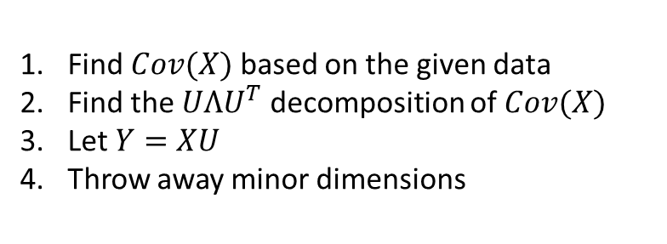
Principal Component Analysis
$$X_{1}$$ | $$X_{2}$$ | $$X_{3}$$ | $$⋯$$ | $$X_{14}$$
$$x_{11}$$ | $$x_{21}$$ | $$x_{31}$$ | $$⋯$$ | $$x_{14,1}$$
$$x_{12}$$ | $$x_{22}$$ | $$x_{32}$$ | $$⋯$$ | $$x_{14,2}$$
$$⋮$$ | $$⋮$$ | $$⋮$$ |  | $$⋮$$
$$x_{1n}$$ | $$x_{2n}$$ | $$x_{3n}$$ | $$⋯$$ | $$x_{14, n}$$
$$Y_{1}$$ | $$Y_{2}$$ | $$Y_{3}$$ | $$⋯$$ | $$Y_{14}$$
$$y_{11}$$ | $$y_{21}$$ | $$y_{31}$$ | $$⋯$$ | $$y_{14,1}$$
$$y_{12}$$ | $$y_{22}$$ | $$y_{32}$$ | $$⋯$$ | $$y_{14,2}$$
$$⋮$$ | $$⋮$$ | $$⋮$$ |  | $$⋮$$
$$y_{1n}$$ | $$y_{2n}$$ | $$y_{3n}$$ | $$⋯$$ | $$y_{14, n}$$
$$X=$$
$$Y=$$
$$x_{2}$$
$$u_{1}$$
$$n×14$$
$$u_{2}$$
Find $Cov(X)$ based on the given data
Find the $UΛU^{T}$ decomposition of $Cov(X)$
Let $Y=XU$
Throw away minor dimensions
$$x_{1}$$

